Slide 1

To Determine the Spring Constant and Effective Mases of a Given Spiral Spring
PRESENTATION ON
Physics 2 Lab
Summer 2021-22 Department of Physics
GROUP - 04
PREPARED BY
1. Ayesha Din Jannat | 21-45948-3
2.Md. Tahsin Hasib | 22-46026-1
3.Md. Jahid Hasan | 22-47010-1
4.Sharon Bhoumick | 19-41534-3
5.Tahasin Ahmed Siam | 22-46773-1
WITH INSIGHT FROM RESPECTED
Dr. Md. Mozahar Ali

Slide 2

TOPICS
Theory
Apparatus
Procedure
Experimental Data
Analysis and Calculation
Result
Discussion

Slide 3
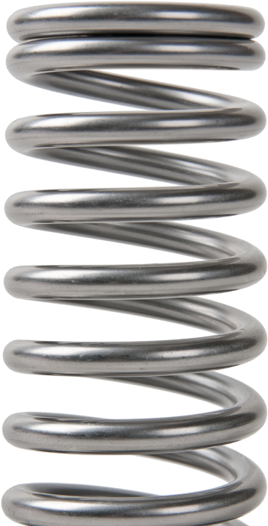

Theory
The Spring constant is a characteristic of a spring that measures the ratio of the force affecting the spring to the displacement caused by it.
Few more characteristics:
Can be expressed as
F=-k$∆x$
When an object applies a force to a spring, then the spring applies an equal and opposite
force to the object
It always acts to restore mass toward its equilibrium position.
Springs with larger spring constants will have smaller displacements than springs with lesser
spring constants for the same mass added.
k (spring constant) is specific for each spring.
spring

Slide 4



Theory
Here,
$$m_{o}g=kl$$
$∴$ $k=\frac{m_{o}}{l}g…………….(1)$
Now the period of vibration of the spring along a vertical line is given by,
$$T=2π\sqrt{\frac{M}{k}}$$
$$T=2π\sqrt{\frac{m_{o}+m^{′}}{k}}……………(2)$$
Where,
𝑚′ = 𝑒𝑓𝑓𝑒𝑐𝑡𝑖𝑣𝑒 𝑚𝑎𝑠𝑠 𝑜𝑓 𝑡ℎ𝑒 𝑠𝑝𝑟𝑖𝑛g
𝑘 = 𝑠𝑝𝑟𝑖𝑛𝑔 𝑐𝑜𝑛𝑠𝑡𝑎𝑛𝑡
$m_{o}$ = 𝑙𝑜𝑎𝑑𝑒𝑑 𝑚𝑎𝑠𝑠
𝑔 = 𝑔𝑟𝑎𝑣𝑖𝑡𝑎𝑡𝑖𝑜𝑛𝑎𝑙 𝑐𝑜𝑛𝑠𝑡𝑎𝑛𝑡
𝑙 = 𝑒𝑥𝑡𝑒𝑛𝑠𝑖𝑜𝑛 𝑜𝑓 𝑡ℎ𝑒 𝑠𝑝𝑟𝑖ng

Slide 5
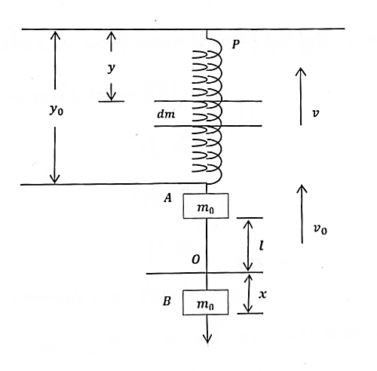

Theory
It is evident that the ratio between $v$ $and$ $v_{o}$ is just the ratio between $y and y_{o}$
Hence, $\frac{v}{y}=\frac{v_{o}}{y_{o}}$
Similarly, we have, $\frac{dm}{m}=\frac{dy}{y_{o}}$
Now the kinetic energy of the spring element ,
$\frac{1}{2}v^{2}dm=\frac{1}{2}\frac{{v_{o}}^{2}}{{y_{o}}^{2}}y^{2}\frac{m_{o}}{y_{o}}dy=\frac{1}{2}\frac{{v_{o}}^{2}}{{y_{o}}^{3}}my^{2}dy$
And the kinetic energy of the spring =
$$\int_{y}^{y_{o}}{\frac{1}{2}\frac{{v_{o}}^{2}}{{y_{o}}^{3}}my^{2}dy}$$
=$\frac{1}{2}(\frac{m}{3}){v_{o}}^{2}$
Measuring spring constant and effective mass

Slide 6

Theory
Then the total kinetic energy of the system
$\frac{1}{2}\left(m_{o}+\frac{m}{3}\right){v_{o}}^{2}$
Therefore, the effective mass of the system
$\left(m_{o}+\frac{m}{3}\right)$
And the effective mass of the spring
$$m^{′}=\frac{m}{3}$$

Slide 7
Apparatus
The components required to carry out this experiment include: -
• A Spiral spring
• Convenient Masses
• Hanging Appeasement
• Clamp
• Stopwatch
• Scale

Slide 8
Procedure
At first the spring was suspended by a hook attached to a rigid framework of heavy metal rods.
Then the length of the spring was measured with a meter scale and a scale was placed behind the spring to measure the extensions of the spring.
Suitable weights were later added to the free end of the spring in order to make it extend to the position O. On the reference frame put behind the spring, the position O and the extension l were noted.
The load was pulled from position O to a moderately low position B and then was released. The spring then executed simple harmonic motion and vibrated up and down about the position O. The time for 20 vibrations was taken with a stop watch and the time period T computed in sec per vibration.

Slide 9
Procedure
Steps (3) and (4) were later repeated for 5 sets of loads.
Afterwards graphs were l drawn with added loads m_0 in grams (abscissa) against the extensions of the spring l in cm (ordinate) and with T^2 as a function of m_0. Then the best fitted lines were drawn through the points.
After that the spring constant was calculated using the slope of the first graph.
The second graph did not pass through the origin owing to the mass of the spring which was not considered in drawing it. The intercept of the resulting line on the mass axis gave the effective mass of the spring.
Finally, the mass m of the spring was measured and that the effective mass obtained from the graph was shown as m^'=m/3.

Slide 10
Experimental Data
No. of obs. | Loads 𝒎𝟎 (gm) | Extension 𝒍 (cm) | No.of vibration 𝒏 | Total time 𝒕 (s) | Time period 𝑻 = 𝒕/𝒏 (s) | 𝑻𝟐 𝒔𝟐
1 | 100 | 3.5 | 20 | 10.77 | 0.54 | 0.291
2 | 125 | 5.5 | 20 | 13.44 | 0.672 | 0.451
3 | 150 | 7.5 | 20 | 15.71 | 0.79 | 0.617
4 | 175 | 10 | 20 | 17 | 0.85 | 0.723
5 | 200 | 12 | 20 | 18.37 | 0.92 | 0.846
6 | 225 | 14.5 | 20 | 19.35 | 0.97 | 0.94
Length of spring, L =11.5 cm
Original mass of the spring =73.4 g

Slide 11
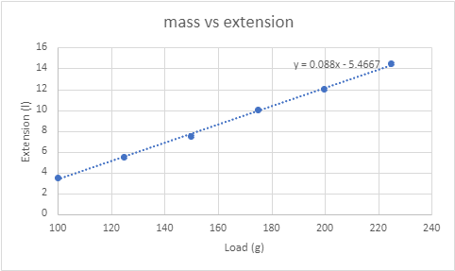

Analysis and Calculation
We know,
k=$\frac{m_{0}}{l}g ⇒k=\frac{g}{(\frac{l}{m_{0}})}$
But $\frac{l}{m_{0}}$ is the slope from the first graph,
$∴k=\frac{g}{Slope} dyne/cm$
Now, For the first graph we have, slope=
$∴k=\frac{g}{Slope}$
=$\frac{980}{0.088}\frac{dyne}{cm}$
=11136.36 $dyne/cm$
First graph – Extension vs. load

Slide 12
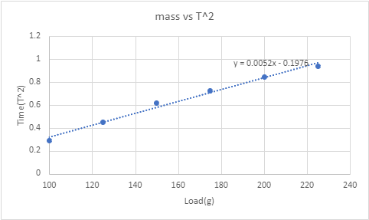

Analysis and Calculation
The original mass of spring, m= 73.4 gm
So, the original effective mass=$\frac{1}{3}m=\frac{1}{3}×$73.4 gm
=24.46 gm
Again, From graph effective mass, m’= $\frac{c}{Slope}$ gm
=$\frac{.1976}{0.0052}$ gm
=38 gm
Percentage (%) of error$=\left|\frac{Original effective mass−Experimental effective mass}{Original effective mass}\right|×100\%$
$=\left|\frac{24.46−38}{24.46}\right|×100\%$
=55.35 %
Second graph – T^2 vs. load

Slide 13
Result
The spring constant, k =11136.36 dyne/cm
Experimental effective mass, 𝑚′ = 38 gm
Percentage (%) of error =55.35 %

Slide 14
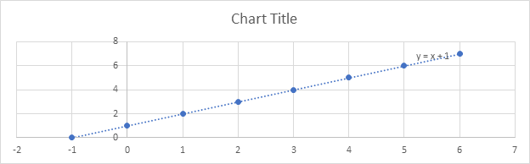

Discussion
The main objective
F=-k$∆x$
Measurements
Systematic error
Risk and softy

Slide 15
THANK YOU SO MUCH

